Slide 1

The Child with a Communicable Disease
Chapter 32
Niomi Quinteros BSN, RN

Slide 2
Review of Terms
Communicable disease—can be transmitted from one person to another
Incubation period—time between exposure to pathogen and onset of clinical symptoms
Prodromal period—time between earliest symptom and appearance of typical rash or fever
Vector—an insect or animal that carries and spreads disease

Slide 3
Review of Terms
Pandemic—a worldwide high incidence of a communicable disease (e.g., H1N1 influenza, COVID 19)
Epidemic—sudden increase of disease in localized area
Endemic—an expected continuous incidence of disease in a localized area
Opportunistic infection—caused by organism normally present in the environment that the immune-suppressed person cannot fight
Health care–associated infection—an infection acquired after admission to a health care facility

Slide 4
Rashes of the Skin
Erythema
Macule
Papule
Vesicle
Pustule
Scab
Pathognomonic

Slide 5
Childhood Communicable Diseases
Vaccines have significantly reduced the rates of childhood diseases.
Health Promotion Box:
Communicable Disease of Childhood

Slide 6
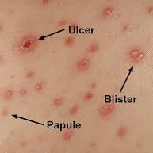
Chickenpox (Varicella)
Signs and Symptoms
Mild fever
Macules, papules, vesicles, pustules, and scabs.
All stages present at the same time
How long Contagious
6 days after appearance of rash
Excluded from daycare until lesions dry
Prevention/Treatment/Nursing Interventions
Varicella vaccine
Airborne isolation precautions
Acyclovir or Immune Globulin
Trim fingernails
Calamine lotion

Slide 7
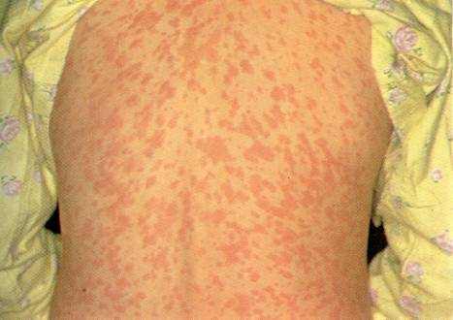
Measles (Rubeola)
Signs and Symptoms
Fever, cough, and conjunctivitis
Koplik spots
Maculopapular rash then erupts
How long Contagious
From 4 days before to 5 days after rash appears
Prevention/Treatment/Nursing Interventions
MMR vaccine
Airborne isolation precautions
Quiet activities
Symptomatic care

Slide 8
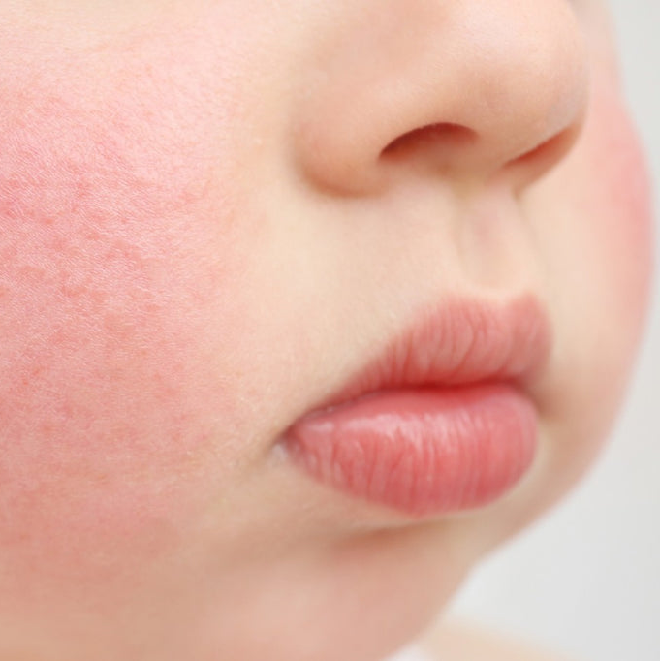
Fifth Disease
Signs and Symptoms
Slapped cheek
Generalized rash subsides, and reappears if irritated by sun or heat
How long Contagious
4-14 days before the rash appears
No longer contagious when rash is present
Prevention/Treatment/Nursing Interventions
Standard precautions
Oatmeal baths for itching

Slide 9

Whooping Cough (Pertussis)
Signs and Symptoms
Fever, cold, cough
Spells of coughing accompanied by a noisy gasp for air that creates a “whoop”
How long Contagious
Several weeks
Excluded from daycare for 5 days after antimicrobial treatment is completed
Prevention/Treatment/Nursing Interventions
DTaP Vaccine
Erythromycin
Droplet precautions for 5 days after antibiotics
Bedrest and cool mist tent
Observe for airway obstruction and O2 saturation

Slide 10
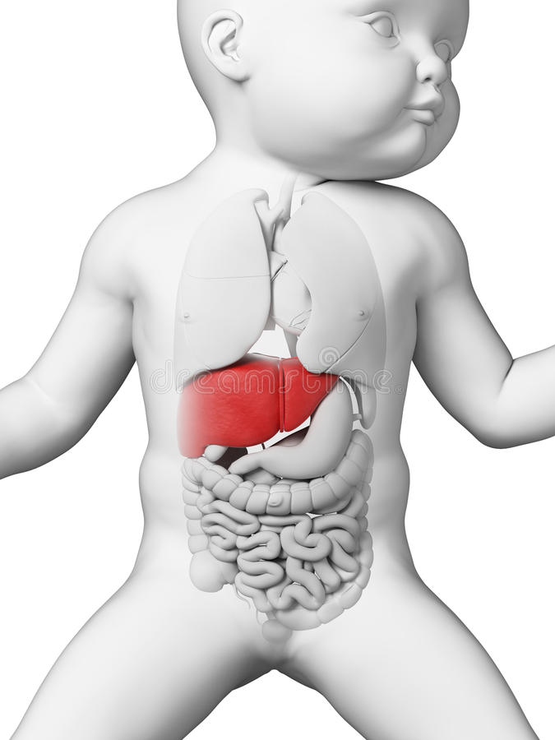
Hepatitis B
Signs and Symptoms
Fever, abdominal pain, headache
Anorexia, malaise
Jaundice, dark urine, chalklike stools
How long Contagious
If the disease is active
Prevention/Treatment/Nursing Interventions
Hepatitis B Vaccine
Interferon or transcriptase inhibitor
Prevent contact with blood
Hepatitis B vaccine- First dose within 12 hours of birth

Slide 11
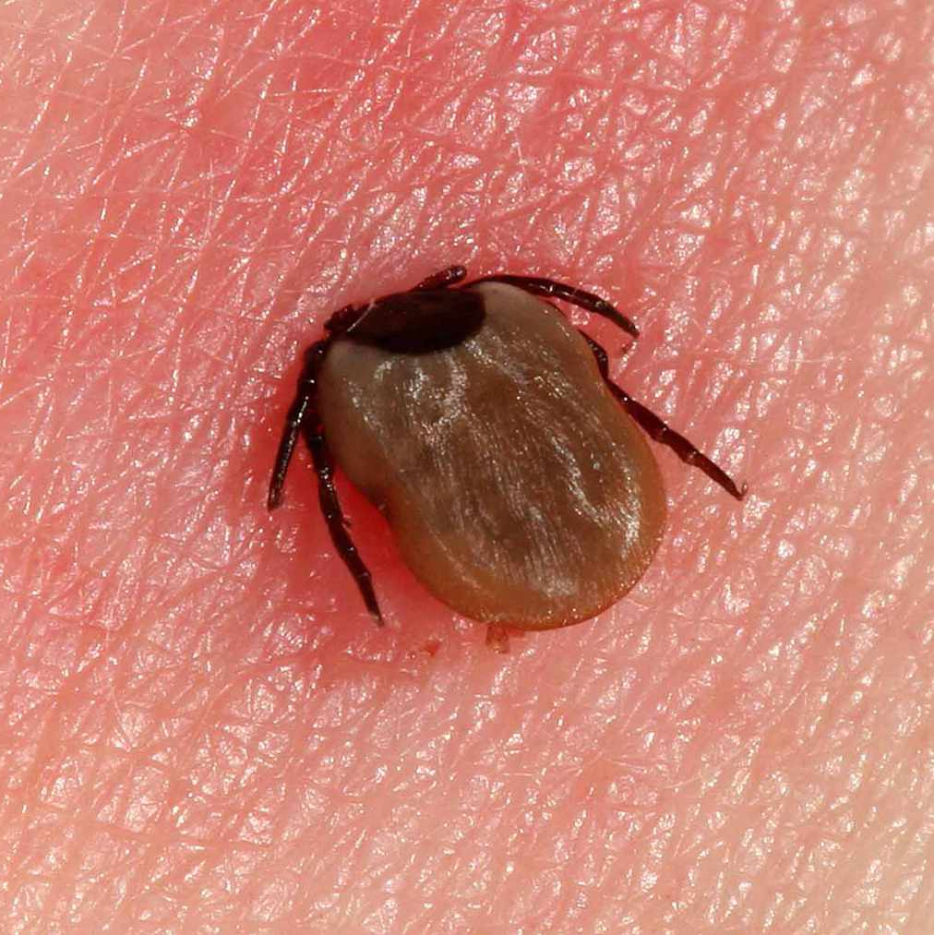
Lyme Disease
Signs and Symptoms
Fever, arthralgia
Macule with raised border and clear center. May burn
Can lead to heart and neurological involvement
How long Contagious
Only spread by infected tick
Prevention/Treatment/Nursing Interventions
Wear protective clothing
Amoxicillin or Doxycycline (Avoid sunlight)
Standard Precautions
Insect repellant containing DEET

Slide 12
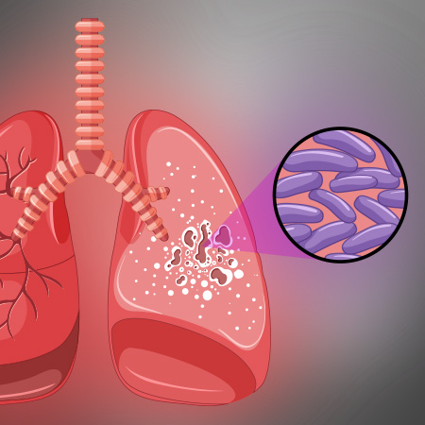
Tuberculosis
Signs and Symptoms
Low-grade fever, malaise, cough, night sweats
Anorexia and weight loss
How long Contagious
2-10 weeks
After treatment has started will need medical clearance to return to daycare
Prevention/Treatment/Nursing Interventions
Isoniazid (NH), Rifampin, and Pyrazinamide (PZA) for several months
Airborne isolation precautions
Identify contacts

Slide 13
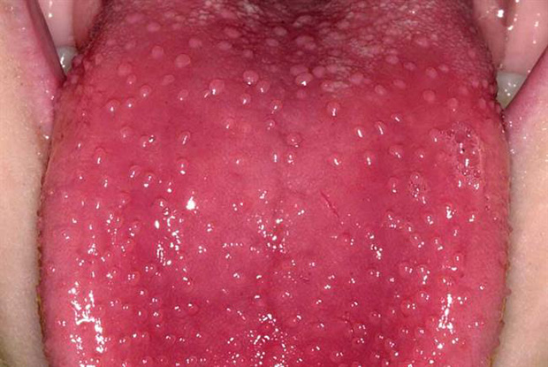
Scarlet Fever
Signs and Symptoms
Tachycardia, strawberry tongue, pinpoint rash, circumoral pallor, desquamation
How long Contagious
2-5 days
Prevention/Treatment/Nursing Interventions
PCN for 10 days
Bed rest and quiet activities
Teaching regarding prevention of streptococcal infection

Slide 14
Pediatric Immunization Schedule
Birth | 2 months | 4 months | 6 months | 12-15 months | 4-6 years | 11-12 years
Hep B | DTap | DTap | DTap | MMR | Varicella | Tdap
 | Rotavirus | Rotavirus | Rotavirus | A Hep |  | HPV
 |  |  |  | DTap (15) | DTap | Meningococcal
 | Hib | Hib | Hib |  | IPV
 | IPV | IPV | IPV | Hib | MMR
 | PCV | PCV | PCV | PCV
 | Hep B |  | Hep B | Varicella

Slide 15
Types of Immunity
Natural
Acquired
Active
Passive

Slide 16
Worldwide Immunization Programs
Healthy People 2030 Framework
The goal for 2030 is to have 95% of all children in the U.S. immunized against childhood communicable diseases
Increase education
Accessibility to health clinics
Reduce the cost of immunizations
Follow-up and track immunizations
CDC provides advice concerning vaccinations needed when traveling

Slide 17
Vaccines
Multiple doses at predetermined intervals may be needed to achieve an immunity
Used to prevent disease; cannot be used to treat disease
Route of administration
Proper storage and handling will ensure potency
Table 32.2Types of Immunization Agents

Slide 18
Allergies and Toxicities
Epinephrine should be available in units where immunizations are given
Child should be observed for 20 minutes after immunization
Do not administer vaccine if the patient is allergic to
Baker’s yeast: avoid recombinant hepatitis B
Eggs: Avoid influenza vaccine and MMR
Neomycin: Avoid IPV, MMR, and Varicella

Slide 19
Contraindications
Compromised immune system
Pregnancy
Serious infection
Immunocompromised caregiver in the home
Steroid therapy
History of very high fever with previous vaccine (over 105 degrees)

Slide 20
Bioterrorism
Immature immune systems
Closer to the ground
New drugs not tested in children
Initial observation
Airway
Breathing
Circulation
Mental status

Slide 21
Sexually Transmitted Infections
Infections can be spread through
Sexual activity
Pregnant mother to fetus
Sexual abuse of a child
Use of contaminated needles or exposure to blood
Nurses are required to report STIs to the local Public Health Department

Slide 22
HPV
Most common STI - adolescents
Increases incidence with multiple partners
Manifestations
Flesh-colored, cauliflower-shaped warts in the perineal area
Prevention
Vaccines given in a 3 series dose
Treatment
Cryotherapy
Electrocautery

Slide 23
Pediatric HIV/AIDS
Symptoms
Failure to thrive
Enlarged lymph glands
Chronic infections
Sinusitis
Pneumonia
UTIs that don’t respond to treatment
Diagnosis: ELISA, Western blot
Medications
AZT (ZDV) given during pregnancy significantly reduces transmission to baby

